Slide 1
Chapter 12: Mass-Storage Systems

Slide 2
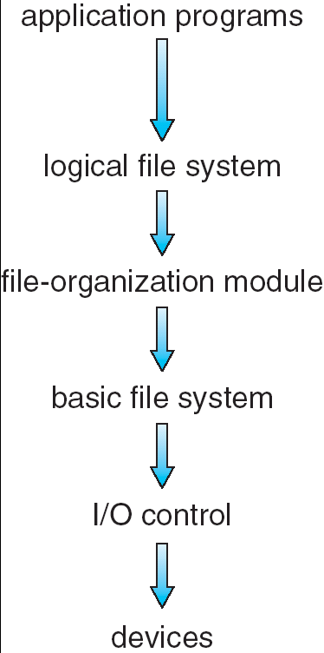
Looked at Interface and Implementation
Now its time for the physical device

Slide 3

Overview of Mass Storage Structure
Magnetic disks provide bulk of secondary storage of modern computers
  Drives rotate at 60 to 200 times per second (7200 RPM = 120 RPS)
  Transfer rate is rate at which data flow between drive and computer
  Positioning time (random-access time) is a combination of:
    time to move disk arm to desired cylinder (seek time)
    and time for desired sector to rotate under the disk head (rotational latency)

Slide 4
IO Bus
Drive attached to computer via a Disk I/O bus
  Busses vary, including EIDE, ATA, SATA, USB, Fiber Channel, SCSI
  Host controller in computer uses bus to talk to disk controller built into drive or storage array
EIDE, ATA, SATA, USB, Fibre Channel, SCSI

Slide 5
Disk Structure
Large 1-dimensional arrays of logical blocks
Sector = block
  Sector 0 is the first sector of the first track on the outermost cylinder.
  Mapping proceeds in order
Sector
Track
Cylinder

Slide 6
Secondary Storage
But…
  File-system installed on a partition (volume)
  Can be multiple partitions to a disk drive
Driver isn’t aware of this structure – just returns a requested block
Layered design means a user can simply ask for a specific block from a specific file-system
OS must translate this to a meaningful lower-level physical drive descriptor
Inode list
Inode list
Boot block
(stage 2 bootloader)
Super block
Super block
----Data blocks---- ----Data blocks----
Master Boot Record
(stage 1 bootloader)
Partitions (or volumes)

Slide 7

Physical Disk Attachment
Host-attached storage accessed through I/O ports talking to I/O busses
  EIDE, ATA, SATA, USB, Fibre Channel, SCSI
At server level, SCSI very popular
  16 devices on one cable, controller can address 8 logical units (disks attached to device controller

Slide 8
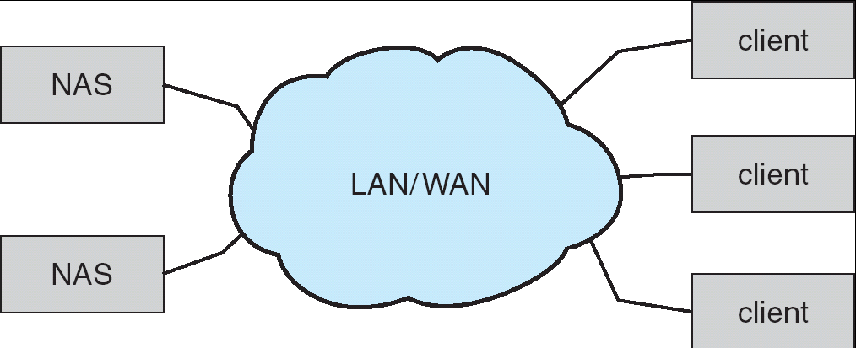
Network-Attached Storage
Network-attached storage (NAS) is storage made available over a network rather than over a local connection (such as a bus)
NFS and CIFS are common protocols
Notes:
At around the time when Sun Microsystems announced WebNFS, Microsoft launched an initiative in 1996 to rename SMB to Common Internet File System (CIFS)

Slide 9
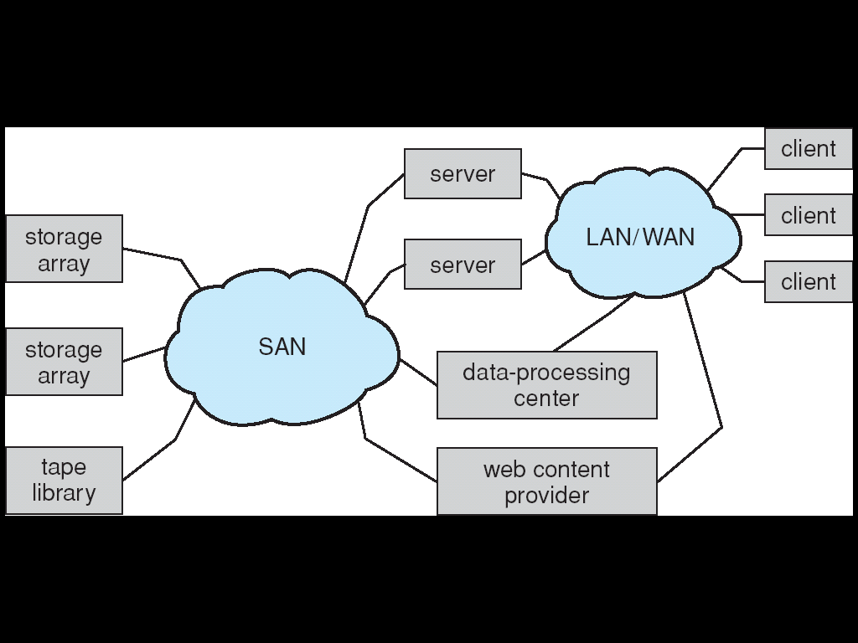
Storage Area Network
Common in large storage environments (and becoming more common)
Multiple hosts attached to multiple storage arrays - flexible

Slide 10

Disk Scheduling
Algorithms
  FCFS
  SSTF
  SCAN
  LOOK

Slide 11
FCFS
Naive approach: not very efficient

Slide 12



SSTF
Shortest Seek Time First

Slide 13


SCAN
All the way from one end to the other and back
Sometimes called the elevator algorithm.

Slide 14

C-SCAN
Circular scan: From beginning to end, but snaps back

Slide 15

LOOK and C-LOOK
Version of C-SCAN, arm doesn’t go all the way

Slide 16
Selecting a Disk-Scheduling Algorithm
SCAN and C-SCAN perform better for systems that place a heavy load on the disk.
  File server, heavy use database
Either SSTF or LOOK is a reasonable choice for the default algorithm.
Disk Scheduling Algorithm
Type of workload

Slide 17
Low-level formatting
Or physical formatting — Dividing a disk into sectors that the disk controller can read and write.
Most modern disks come pre-formatted from the factory
DOS format utility for floppies
BIOS utility (debug initiated init) for older hard drives

Slide 18
Partitioning
To use a disk to hold files, the operating system still needs to record its own data structures on the disk.
  Partition the disk into one or more groups of cylinders.
Unix: fdisk, gparted, Partition Magic
DOS: fdisk

Slide 19
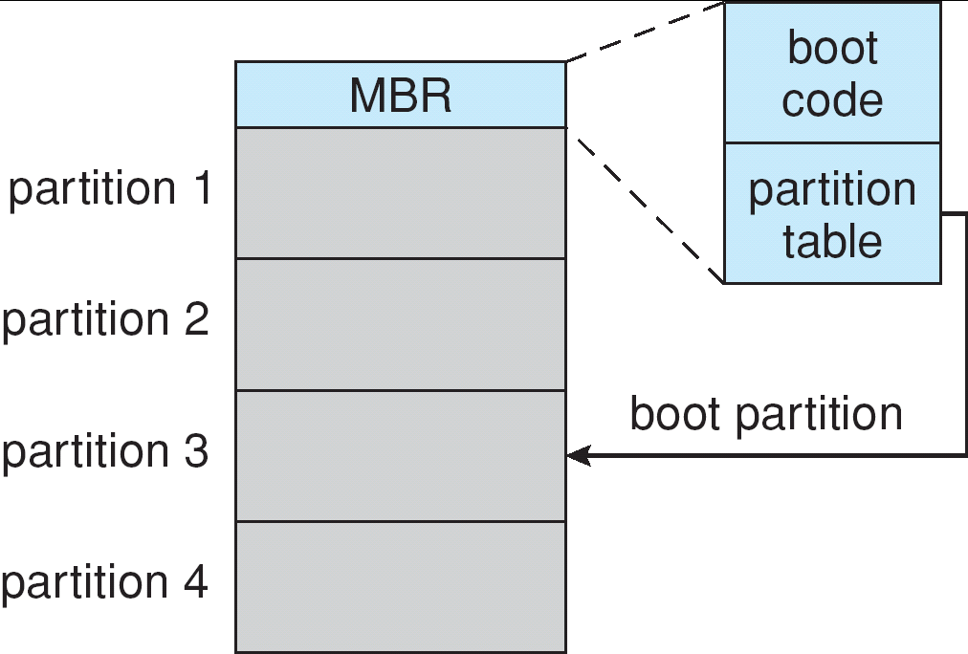
High level formatting
  Logical formatting or “making a file system”
  Make partition bootable
DOS: format
(for hard drives)
Unix: mkfs, gparted,

Slide 20
Bad Blocks
Identified at low-level format time
List managed by operating system
Spare blocks (sectors) reserved
  Data slated for the bad block redirected to spare
  Known as sector sparing
Bad Block List
----
----
----
----
----
----
----

Slide 21
Swap-Space Management
Swap-space — demand paging
Often a separate disk partition: raw, no file-system
Under direct control of memory manager
  Can place on disk at start (4.3BSD, text and data)
  Some wait till swap (Solaris 2)
Disk
Root
partition
Swap partition
User partition

Slide 22

Buffers
Especially important in File Servers
Network
File Server
Buffers

Slide 23
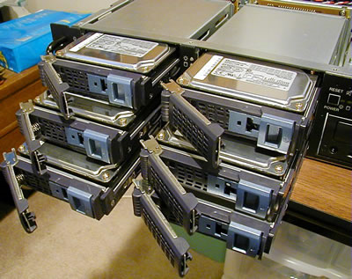

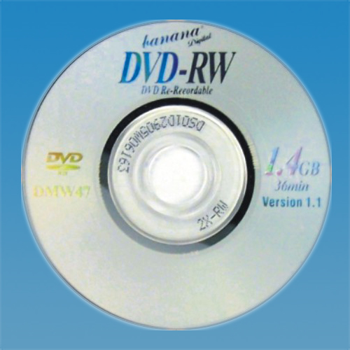
Several related topics
RAID
Tertiary storage
Worm drives
Cost

Slide 24
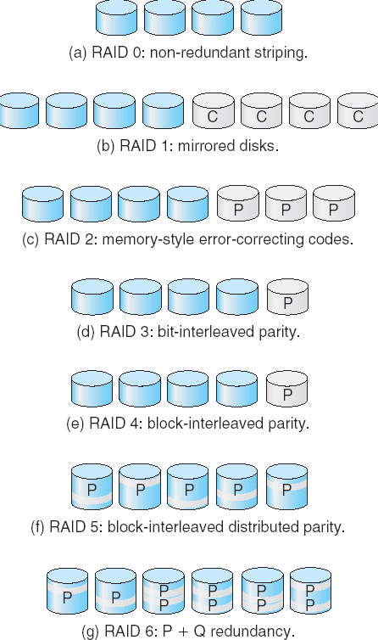
RAID Structure
Redundant array of inexpensive disks
Levels
  RAID 0: Block-level striping (blocks distributed across drives), can pull in parallel
  RAID1: mirrored (redundancy)
  RAID 2: Bit-level striping with checksums
  RAID 3: Bit-level striping with interleaved parity (takes advantage of controller intelligence)
  RAID 4: Block-level striping
  RAID 5: Block-level with distributed parity (avoids overuse of parity drive)
  RAID 6: Like 5 but extra parity info (guard against multiple drive failures)

Slide 25
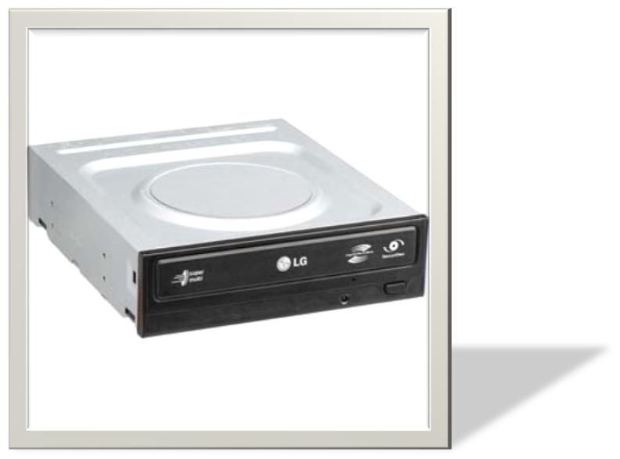
Tertiary Storage Devices
Low cost is the defining characteristic of tertiary storage (3rd level, vs. Secondary)
  Generally, tertiary storage is built using removable media
  Tape, floppies, CDs, DVDs

Slide 26
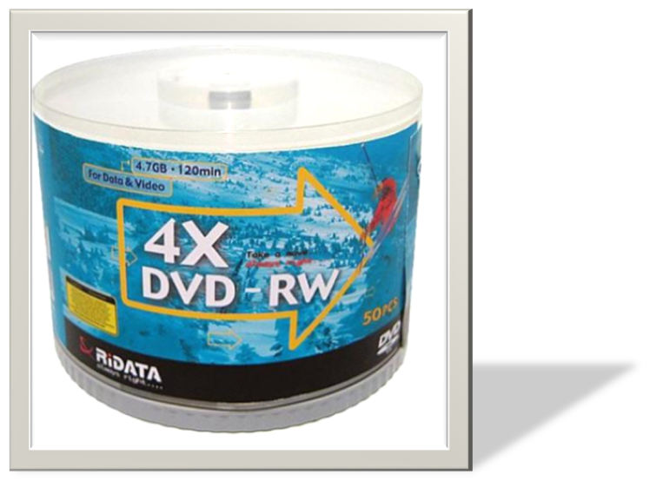
WORM Disks
The data on read-write disks can be modified over and over.
  CD-RW and DVD-RW
WORM (“Write Once, Read Many Times”) disks can be written only once.
  CD-R and DVD-R (+R)
Notes:
The DVD+R format is divergent from the DVD-R format. Hybrid drives that can handle both, often labeled "DVD±RW", are very popular since there is not a single standard for recordable DVDs. There are a number of significant technical differences between the "dash" (it's not a minus symbol) and the "plus" format, although most users would not notice the difference. One example is the DVD+R style ADIP (ADdress In Pregroove) system of tracking and speed control being less susceptible to interference and error which makes the ADIP system more accurate at higher speeds than the LPP (Land Pre Pit) system used by DVD-R. In addition, DVD+R(W) has a more robust error management system than DVD-R(W), allowing for more accurate burning to media independent of the quality of the media. Additional session linking methods are more accurate with DVD+R(W) versus DVD-R(W), resulting in fewer damaged or unusable discs due to buffer under-run and multi-session disks with fewer PI/PO errors.^{[3]}

Slide 27
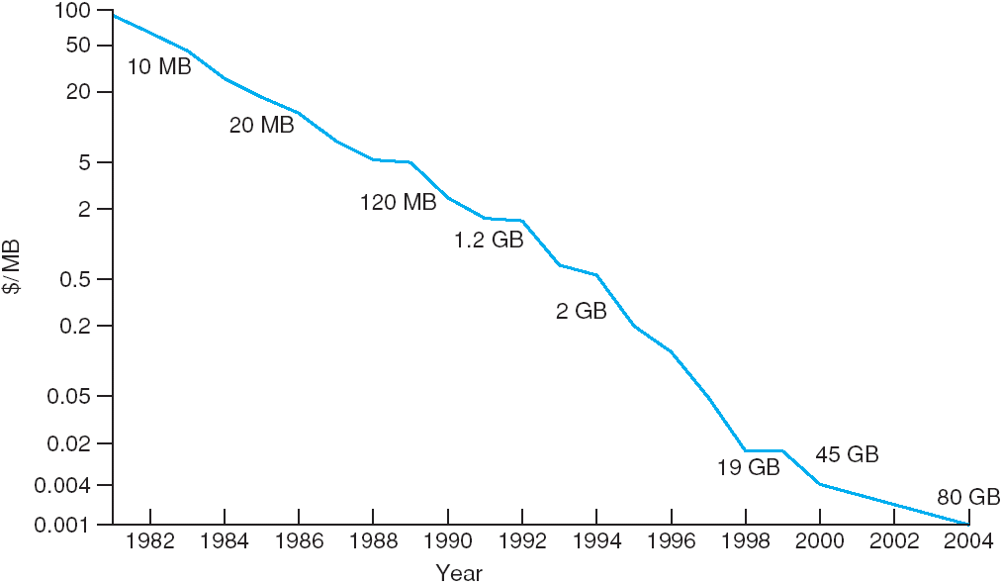
Price per Megabyte of Magnetic Hard Disk, From 1981 to 2004

Slide 28
End of Chapter 12

